Slide 1
70-530 Data Visualization
Week 6 – Visualization of Multi(High)-Dimensional Data

Slide 2
Objectives
Visualizing multi-dimensional data with correlation matrix, pair-wise scatter plot, and parallel coordinates.
Principles of two dimension-reduction methods: PCA and t-SNE.
Case studies of high-dimensional data visualization

Slide 3
Ubiquity of Multi-dimensional Data
A dataset usually has multiple dimensions (or attributes, features, variables)
Iris flower: length and width of sepals and petals
Person: height, weight, eye color, age, sex, ethnicity, major, occupation…
Stock: price, earnings per share, market capitalization, trading volume, dividend rate, price-to-earning ratio…
Blood test report: glucose, cholesterol, blood cell count, other 100+ measurements
Image: each pixel being a dimension and the color being the value (hundreds of dimensions)
Gene expression: expression levels of thousands of genes
H-D

Slide 4
Why Visualizing Multi-dimensional Data?
First look at the data
Understand the correlation between attributes
See clusters and patterns
Help with modeling

Slide 5
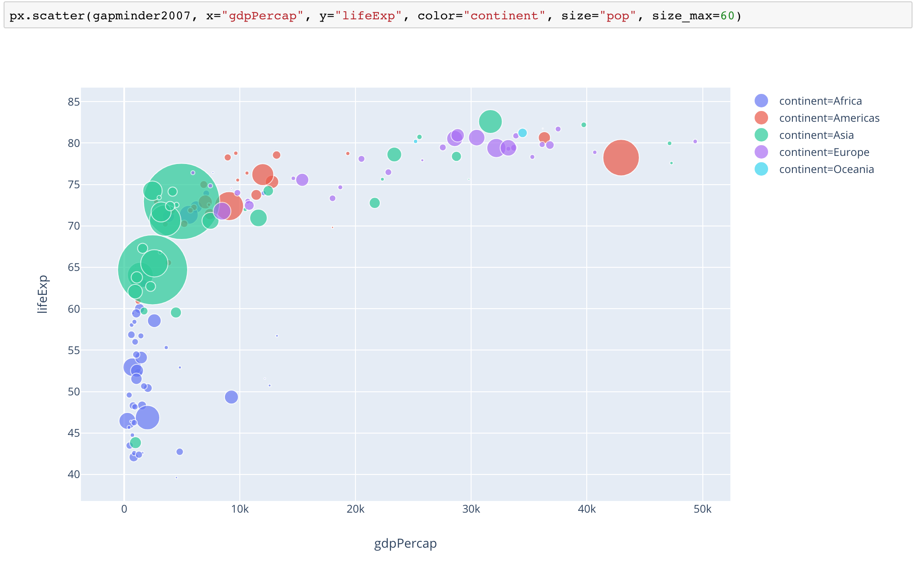
Visualizing Multi-dimensional Data by Multiple Encodings
Scatter plot +
size (for quantities) +
color (for quantities or categories) +
shape (for categories)
bubble chart
bubble size = population

Slide 6
Visualizing Multi-dimensional Data by Multiple Encodings
Use time as a dimension by making an animated plot for other attributes over time.

Slide 7
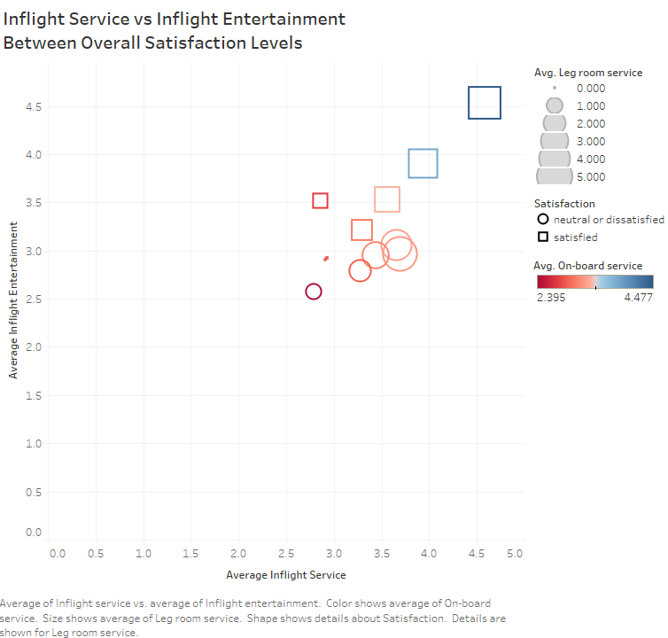
Visualizing Multi-dimensional Data by Multiple Encodings
source: Jenna Lopes

Slide 8
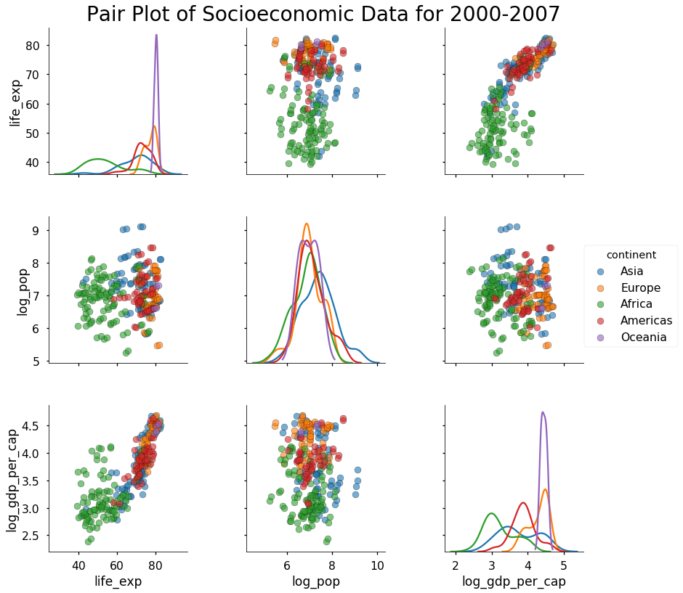
Visualizing Multi-dimensional Data by Pair-wise Scatter Plots

Slide 9
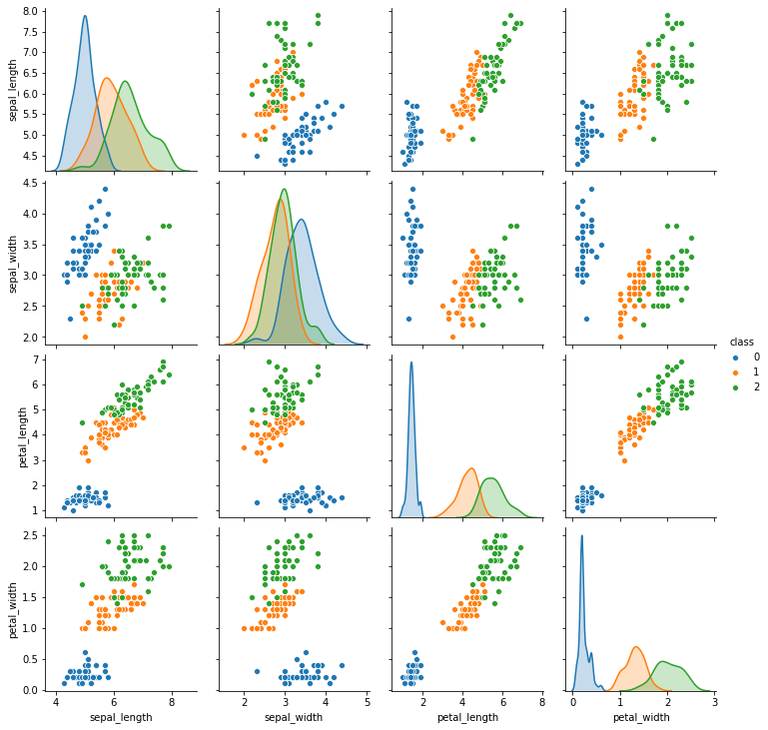
Visualizing Multi-dimensional Data by Pair-wise Scatter Plots
Pair-wise Scatter Plots for Iris Features

Slide 10
Usage of Pair-wise Scatter Plots
Comprehensive first look at a dataset
Feature correlation
Collinearity
Is linearly separable?

Slide 11
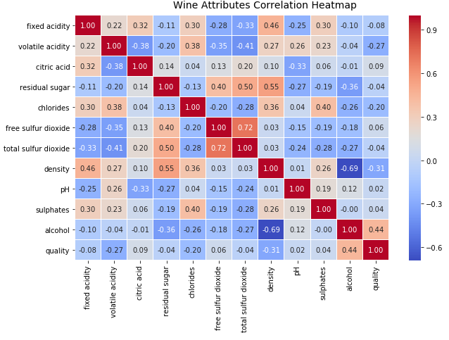
Visualizing Multi-dimensional Data by Correlation Matrix
Wine Attributes Correlation Matrix

Slide 12
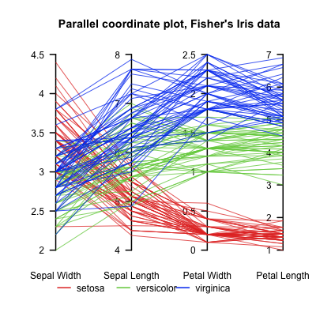
Visualizing Multi-dimensional Data by Parallel Coordinates
Vertical parallel lines: dimensions
Polylines: data points
Parallel Coordinates Plot for Iris Features

Slide 13
Dimension Reduction
For high-dimensional data, dimension reduction may be applied before visualization.
Two commonly used dimension reduction techniques:
Principal Component Analysis (PCA)
t-Distributed Stochastic Neighbor Embedding (t-SNE)

Slide 14
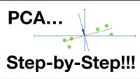
Principle of PCA

Slide 15
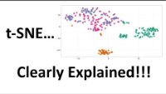
Principle of t-SNE

Slide 16
Summary of PCA and t-SNE
PCA
Projects data points to a low dimensional coordinate system in which the first axis (principal component) is oriented in the data's direction of maximal variation, the second axis is oriented in the direction of the next greatest amount of variation that is orthogonal to the first axis, and so on.
Preserves variation of data.
t-SNE
Minimizes the divergence between two distributions: a distribution that measures pairwise similarities of the input objects and a distribution that measures pairwise similarities of the corresponding low-dimensional points in the embedding
Preserves pairwise similarities.

Slide 17

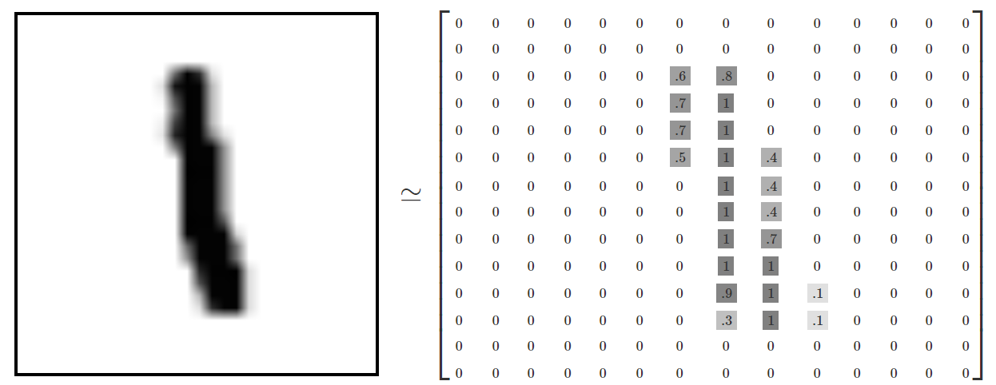
Case Study 1: Visualizing MNIST
The MNIST dataset consists of 70,000 28x28 pixel images of digits handwritten by US high school students and Census Bureau employees. Example:
Every image can be thought of as a matrix of numbers describing how dark each pixel is. For example,
Every image can be also thought of as a 28x28=784 dimensional vector.

Slide 18
Visualizing MNIST with PCA and t-SNE
Demonstration on a Jupyter Notebook

Slide 19
Case Study 2: Visualizing Word Embedding
For a computer to understand the meaning behind a word, the word needs to be encoded into a numeric form, hence word embedding.
Objective: encode each word as a point in a high-dimensional space such that the words that are close in this space are similar in meaning.
Example models: word2vec and GloVe.
GloVe (the subset we will demonstrate):
Trained with Wikipedia2014+Gigaword5 based on word-word co-occurrence statistics
6B tokens, 400K vocabulary, 100D vectors

Slide 20
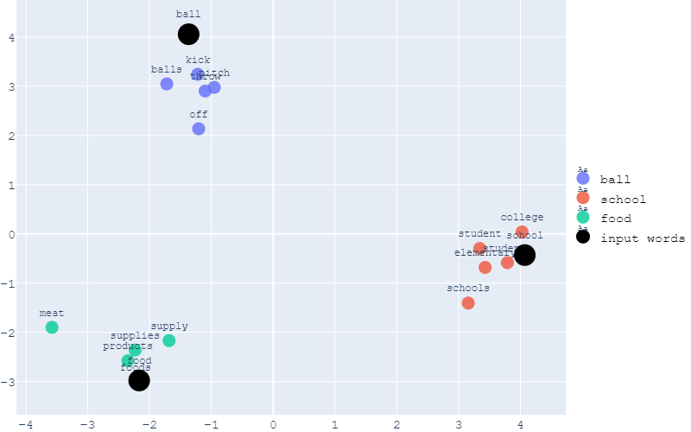
Visualizing with PCA
Conduct PCA to reduce from 100D to 2D
For a given input word (e.g., school), find 5 closest words in the 100D space and plot them in the 2D space.

Slide 21
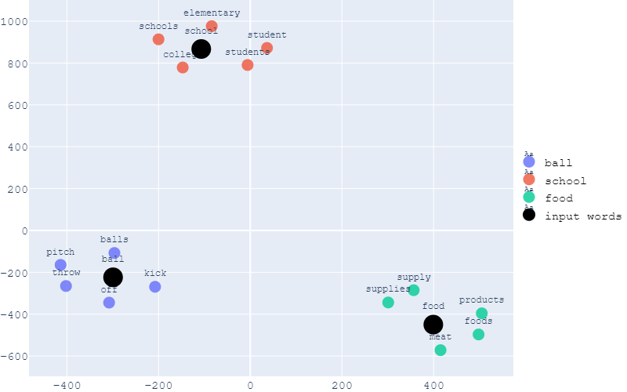
Visualizing with t-SNE
Conduct t-SNE to reduce from 100D to 2D
For a given input word (e.g., school), find 5 closest words in the 100D space and plot them in the 2D space.

Slide 22
References
Dipanjan Sarkar, The Art of Effective Visualization of Multi-dimensional Data, Jan. 2018. https://towardsdatascience.com/the-art-of-effective-visualization-of-multi-dimensional-data-6c7202990c57.
Luuk Derksen, Visualising high-dimensional datasets using PCA and t-SNE in Python, Oct. 2016. https://towardsdatascience.com/visualising-high-dimensional-datasets-using-pca-and-t-sne-in-python-8ef87e7915b.
Ruben Winastwan, Visualizing Word Embedding with PCA and t-SNE, Oct. 2020. https://towardsdatascience.com/visualizing-word-embedding-with-pca-and-t-sne-961a692509f5.
Visualizing MNIST: An Exploration of Dimensionality Reduction, Oct. 2014. https://colah.github.io/posts/2014-10-Visualizing-MNIST/.
Introducing Plotly Express. https://medium.com/plotly/introducing-plotly-express-808df010143d.

